Slide 1

Installing - Using
Presentation
By Anas BENOMAR
Saida EZ-ZOUJARY

Slide 2

Popular, open-source NoSQL (non-relational) database management system that stores data in a flexible, JSON-like format called BSON (Binary JSON). It is designed to handle large amounts of data and provide high performance, scalability, and flexibility.

Slide 3
01
Installing MongoDB

Slide 4
A - Download the installer
Download the MongoDB Community .msi installer from the following link: https://www.mongodb.com/try/download/community
In the Version dropdown, select the version of MongoDB to download.
In the Platform dropdown, select Windows.
In the Package dropdown, select msi.
Click Download.

Slide 5
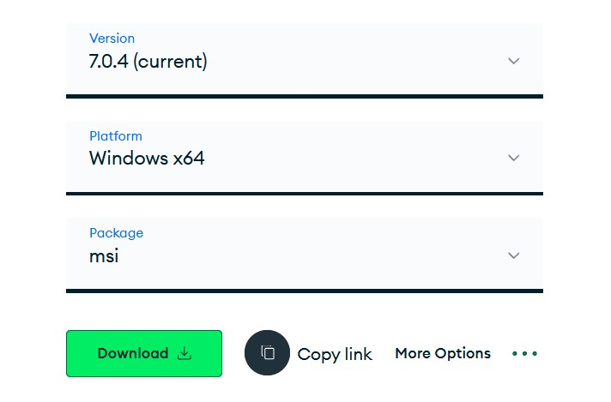
A - Download the installer
a
b
c
d

Slide 6
B - Run the MongoDB installer
Go to the directory where you downloaded the MongoDB installer (.msi file). By default, this is your Downloads directory.
Double-click the .msi file.

Slide 7
C - Follow the MongoDB Community Edition installation wizard.
The wizard steps you through the installation of MongoDB and MongoDB Compass.

Slide 8
C - Follow the MongoDB Community Edition installation wizard
Choose Setup Type
Service Configuration
You can choose either the
Complete (recommended for most users) or Custom setup type.
you can set up MongoDB as a Windows service during the install or just install the binaries.

Slide 9
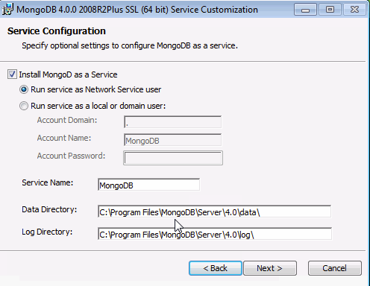
C - Follow the MongoDB Community Edition installation wizard

Slide 10
C - Follow the MongoDB Community Edition installation wizard
Install MongoDB Compass
Optional. To have the wizard install MongoDB Compass, select Install MongoDB Compass (Default).

Slide 11
D – Install mongosh
Open the MongoDB Shell download page: https://www.mongodb.com/try/download/shell?jmp=docs
In the Platform dropdown, select Windows 64-bit (8.1+) (MSI)
Click Download.
Double-click the installer file.
Follow the prompts to install mongosh.

Slide 12
D – Install mongosh
Add the mongosh binary to your PATH environment variable
Open the Control Panel.
In the System and Security category, click System.
Click Advanced system settings. The System Properties modal displays.
Click Environment Variables.
In the System variables section, select Path and click Edit. The Edit environment variable modal displays.

Slide 13
D – Install mongosh
Add the mongosh binary to your PATH environment variable
Click New and add the filepath to your mongosh binary.
Click OK to confirm your changes. On each other modal, click OK to confirm your changes.

Slide 14
D – Install mongosh
Confirm that your PATH environment variable is correctly configured
Open a command prompt and enter the mongosh --help command. If your PATH is configured correctly, a list of valid commands displays.

Slide 15
02
Using MongoDB

Slide 16
A) CRUD Operations
CRUD (Create, Read, Update, Delete) operations represent the core functionalities for interacting with and managing data in a database, encompassing the actions of creating, retrieving, modifying, and deleting records.

Slide 17
A) CRUD Operations
Create (insert)
To create or insert a document into a MongoDB collection, you use the insertOne or insertMany method.
db.users.insertOne({
name: "John Doe",
age: 30,
email: "john@example.com"
});

Slide 18
A) CRUD Operations
Read (Query)
Reading or querying documents is done using the find method. You can specify criteria to filter the results.
// Find all documents in the "users" collection
db.users.find();
// Find users older than 25
db.users.find({ age: { $gt: 25 } });

Slide 19
A) CRUD Operations
Update
Updating documents is performed using the updateOne or updateMany method. You can use update operators like $set to modify specific fields.
db.users.updateOne(
{ name: "John Doe" },
{ $set: { email: "john.doe@example.com" } }
);

Slide 20
A) CRUD Operations
Delete
Deletion of documents is done using the deleteOne or deleteMany method.
// Delete a document with a specific name
db.users.deleteOne({ name: "John Doe" });
// Delete all users with age less than 21
db.users.deleteMany({ age: { $lt: 21 } });

Slide 21
B) Indexes
Indexing makes columns faster to query by creating pointers to where data is stored moving within a database

Slide 22
B - Indexes
Single Field Index:
An index created on a single field within a document.
Improves the speed of queries that filter or sort by the indexed field.
db.users.createIndex({ username: 1 });

Slide 23
B - Indexes
Text Indexes:
Specifically designed for full-text search queries.
Tokenizes and indexes the content of string fields, enabling efficient text-based searches.
db.articles.createIndex({ description: "text" }) // Usage db.articles.find({ $text: { $search: "MongoDB tutorial" } });

Slide 24
C - Validation
Data validation is crucial for maintaining data integrity and ensuring accurate and reliable information in a database.

Slide 25
Creating a collection with schema validation
C - Validation
db.createCollection("employees", {
validator: {
$jsonSchema: {
bsonType: "object",
required: ["name", "age", "position"],
properties: {
name: { bsonType: "string", description: "must be a string" },
age: { bsonType: "int", description: "must be an integer" },
position: { bsonType: "string", description: "must be a string" }
}
}
}
});
Within the createCollection method, use the validator option to specify a validation rule.
he $jsonSchema field encapsulates the JSON Schema document containing validation rules.

Slide 26
Creating a collection with schema validation
C - Validation
db.createCollection("employees", {
validator: {
$jsonSchema: {
bsonType: "object",
required: ["name", "age", "position"],
properties: {
name: { bsonType: "string", description: "must be a string" },
age: { bsonType: "int", description: "must be an integer" },
position: { bsonType: "string", description: "must be a string" }
}
}
}
});
Within the createCollection method, use the validator option to specify a validation rule.
he $jsonSchema field encapsulates the JSON Schema document containing validation rules.

Slide 27
Creating a collection with schema validation
C - Validation
Required Fields: required: ["name", "age", "position"]
Properties: defines individual properties (fields) within the document.

Slide 28
Disable Validation
C - Validation
bypassDocumentValidation : used to temporarily disable the application of validation rules defined on a collection when performing specific operations.
// Example: Inserting a document with validation bypassed
db.employees.insert(
{ name: "Charlie", age: "invalid", position: "Manager" },
{ bypassDocumentValidation: true }
);

